Slide 1
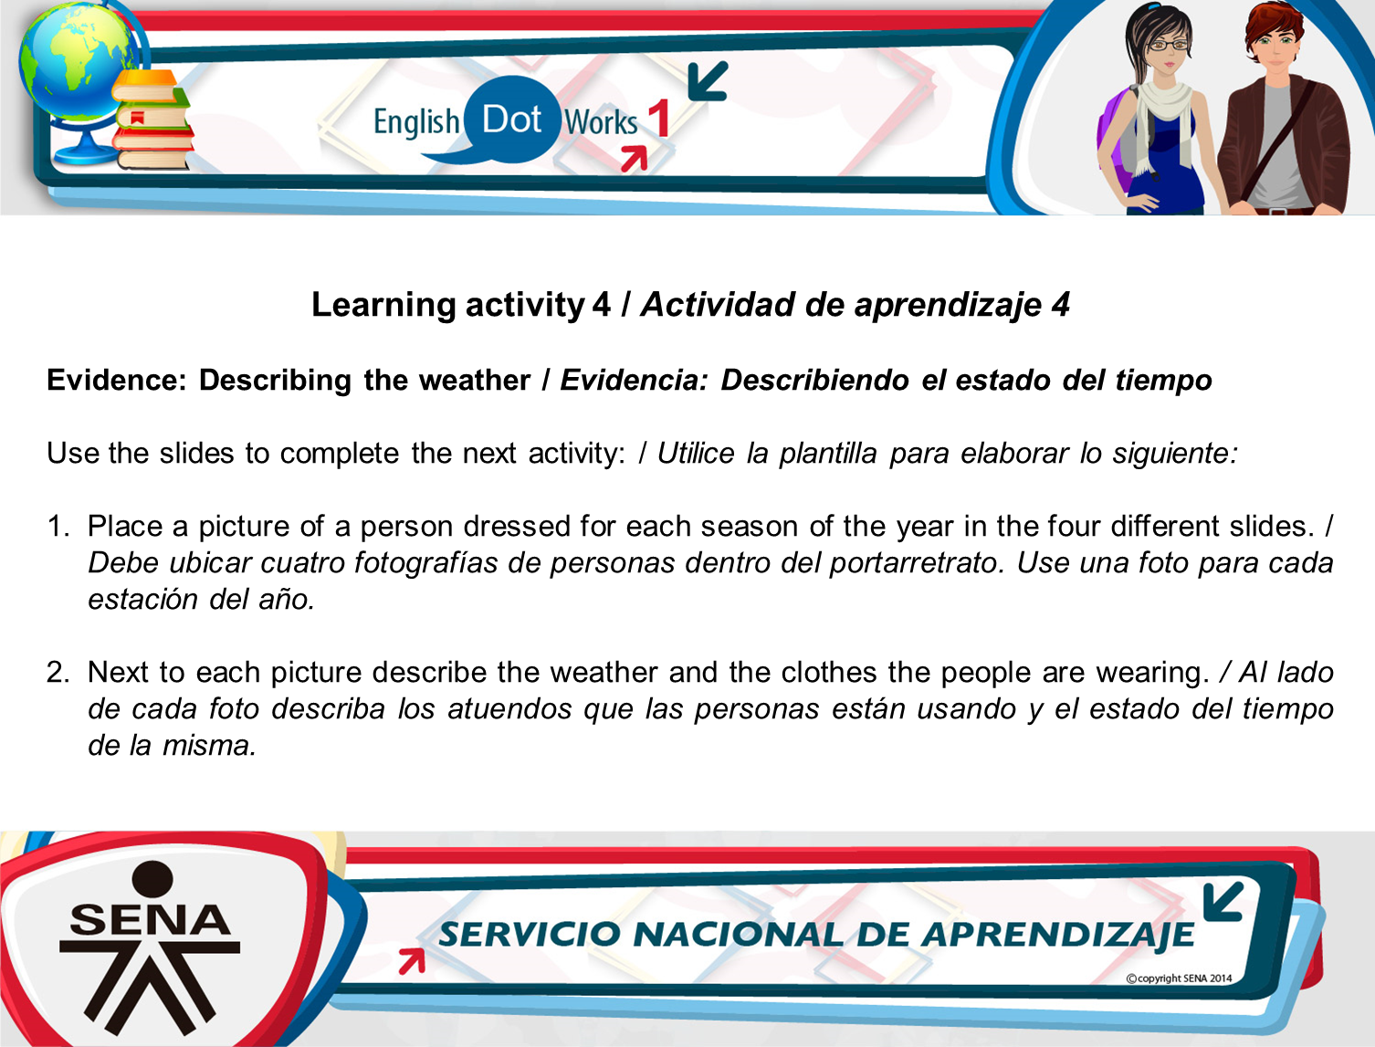


Slide 2
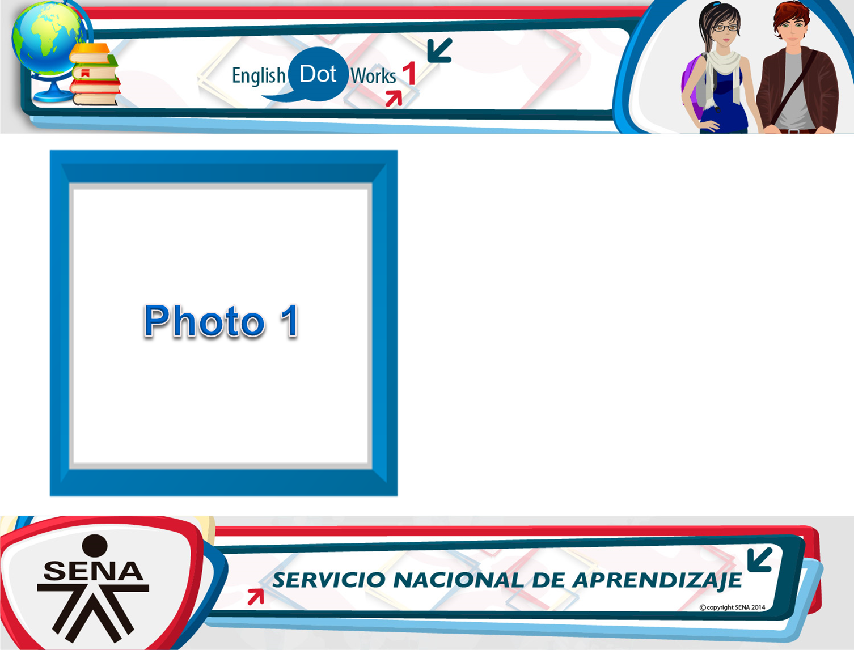
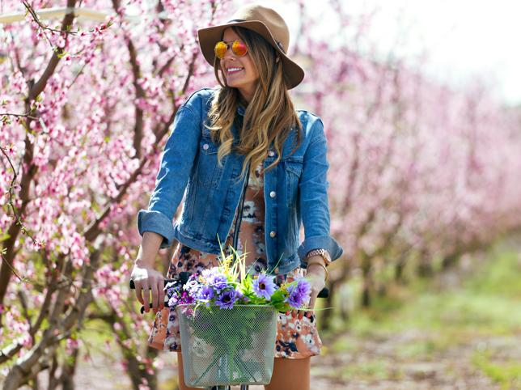
Description of weather and clothes: It’s spring. It’s a warm sunny day. The girl is wearing a brown hat, spring glasses, blue jacket and a flower dress.

Slide 3
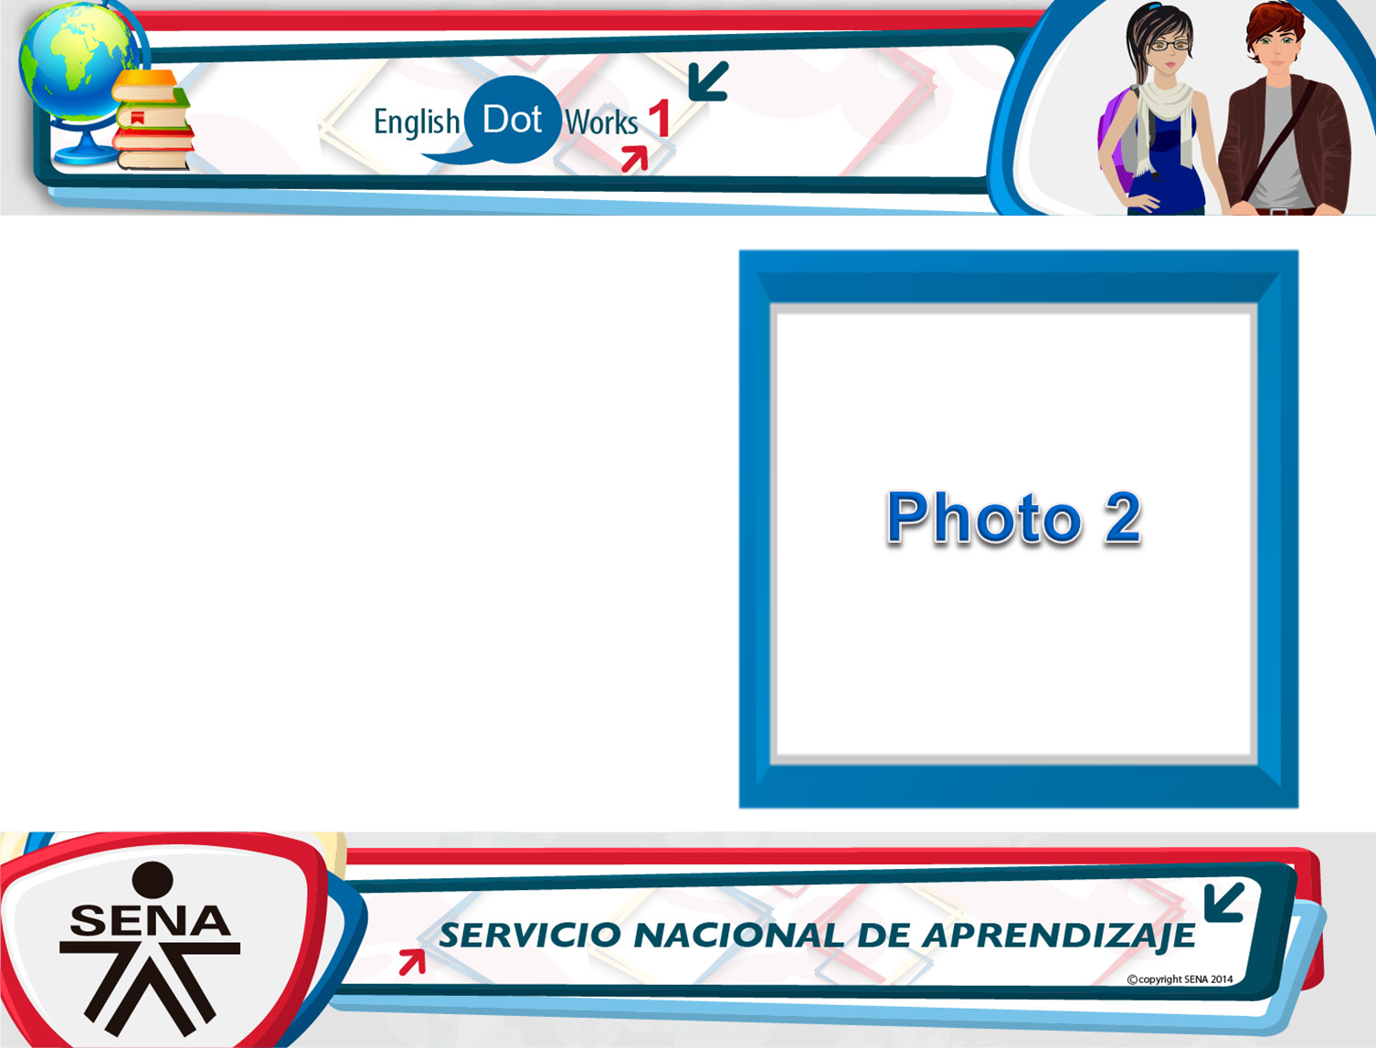
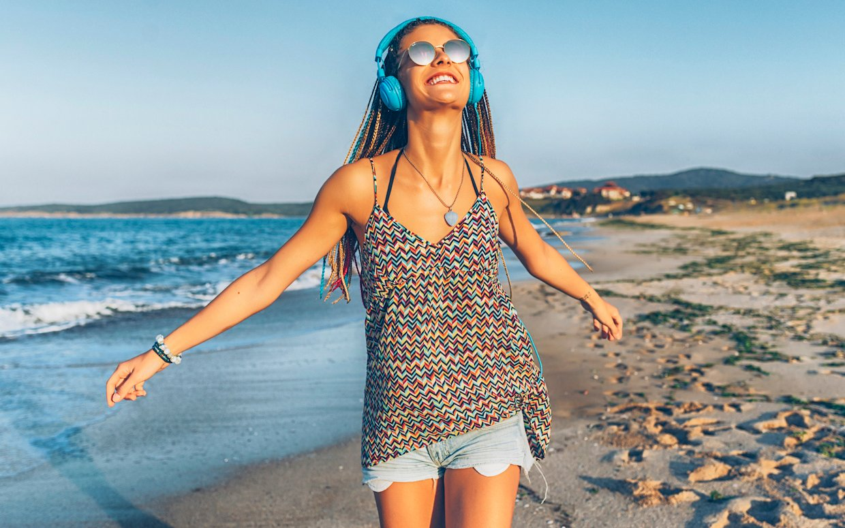
Description of weather and clothes: It’s summer. It’s a hot sunny day with a blue sky. The girl is wearing glasses, blue headphones, a colored blouse, blue shorts, a necklace and a bracelet.

Slide 4

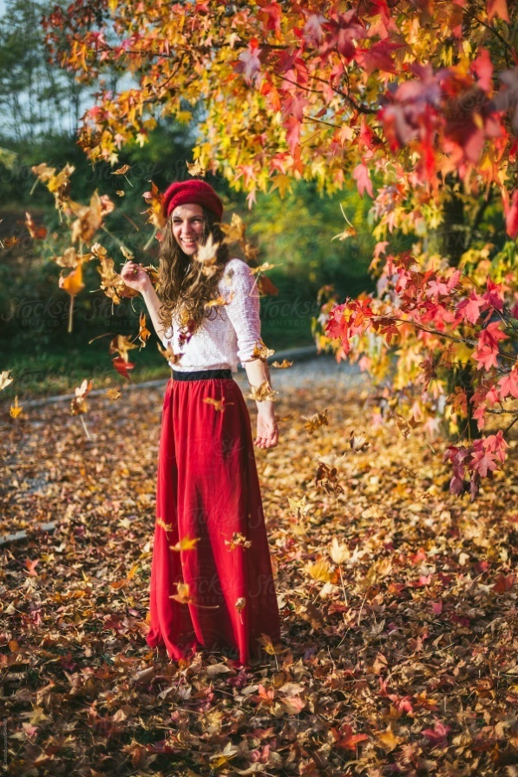
Description of weather and clothes: It’s fall season. It’s a warm cloudy day. The woman is wearing a red hat, pink blouse and a red skirt.

Slide 5

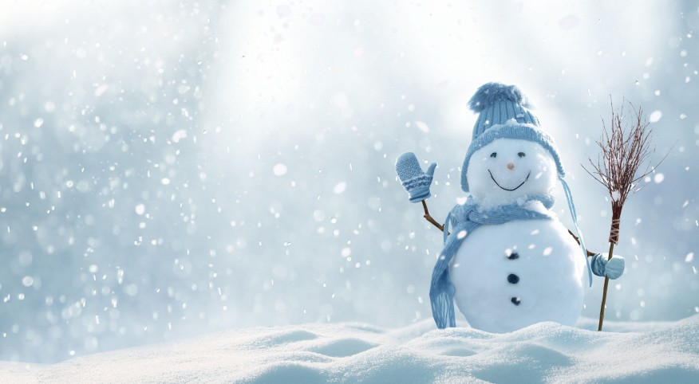
Description of weather and clothes: It’s winter. It’s a cloudy snowy day. The snowman is wearing a blue hat, a blue scarf and blue gloves.

Slide 6
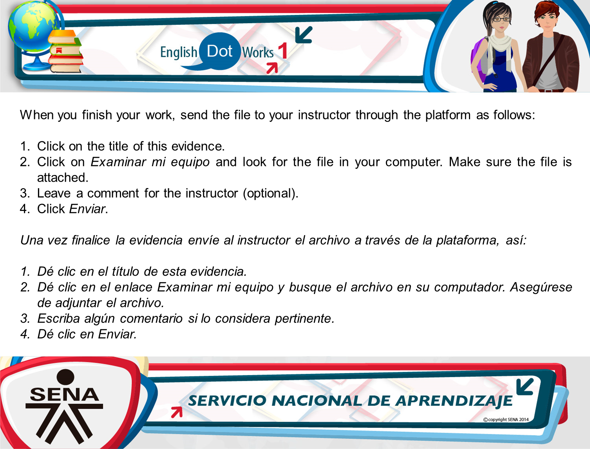
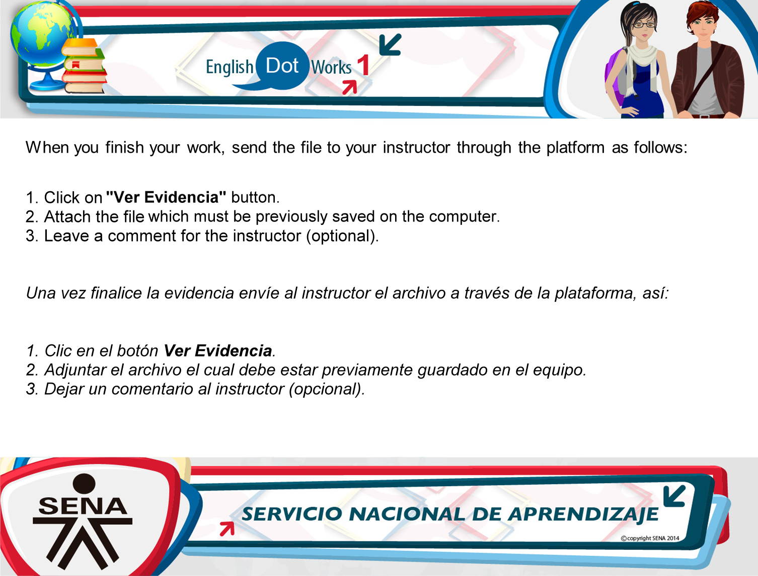
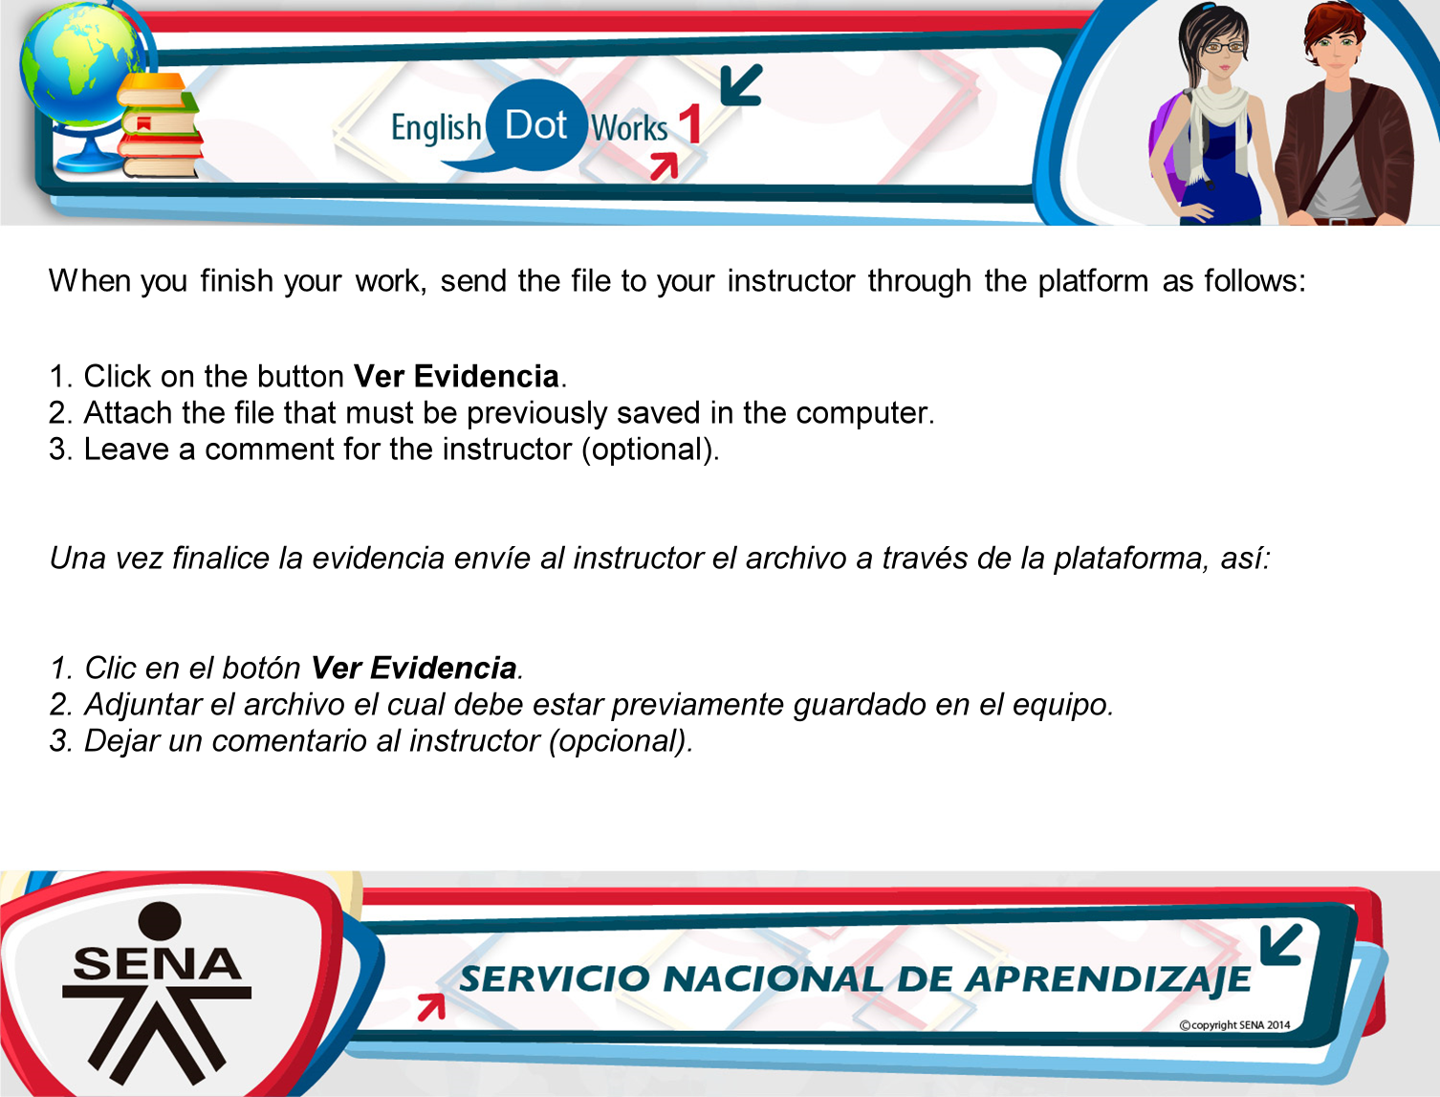

Slide 7
